Slide 1

Video-Enhanced Learning Companion & Co-Pilot Video to Text Approach (2nd Gen)
Name: Nicole Kaira Almonte Imatong
Project ID: CCDS24-1273
Supervisor: Mr. Ong Chin Ann
Notes:
Good afternoon, my name is Nicole. Today I’ll be presenting my Final Year Project, titled Video-Enhanced Learning Companion & Co-Pilot, Video-to-Text Approach, Second Generation.

Slide 2
Table of contents
01
02
03
Introduction
Implementation
Evaluation
04
05
Demonstration
Conclusion
Notes:
Here’s today’s outline: Introduction, Implementation, Evaluation, Demonstration, and Conclusion.

Slide 3
01
Introduction
Background | Baseline System | Objective

Slide 4
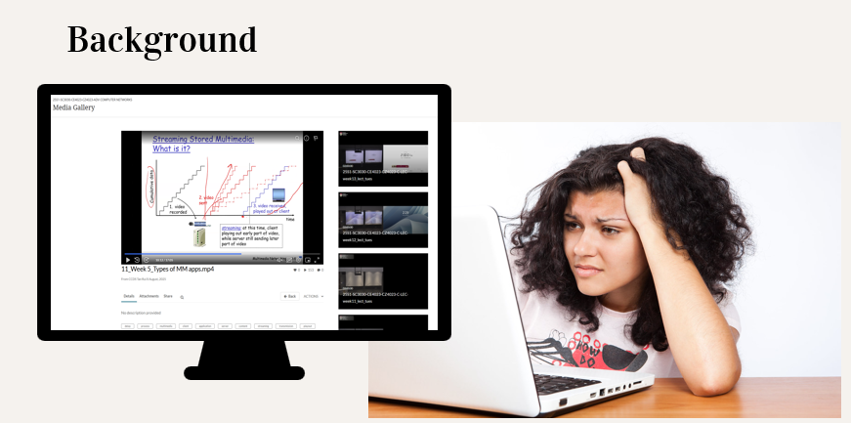


Background
Growth of Generative AI in Education
Issues Students Face with AI tools
Recent advances in generative AI
Use AI for explanations, summaries, tutoring, and revision.
Most AI tools are generic
AI Hallucinated answers when asked about specific modules.
Students spend a lot of time scrubbing through long lecture videos to find explanations.
Notes:
Students rely heavily on generative AI for explanations, summaries, and revision. However, most AI tools are generic and do not understand module-specific content. They hallucinate, cannot reference lecture materials, and students end up scrubbing through long lectures to find answers manually

Slide 5

Gap in Learning Experience
AI that can ground its answers in the actual lecture videos.
Solution:
Video-Enhanced Learning Companion & Co-Pilot Video to Text Approach (1st Gen)
Notes:
This creates a gap: students need AI that grounds its answers in the actual lecture videos.
The first-generation system attempted to address this using a basic Retrieval-Augmented Generation system (RAG) for short.

Slide 6
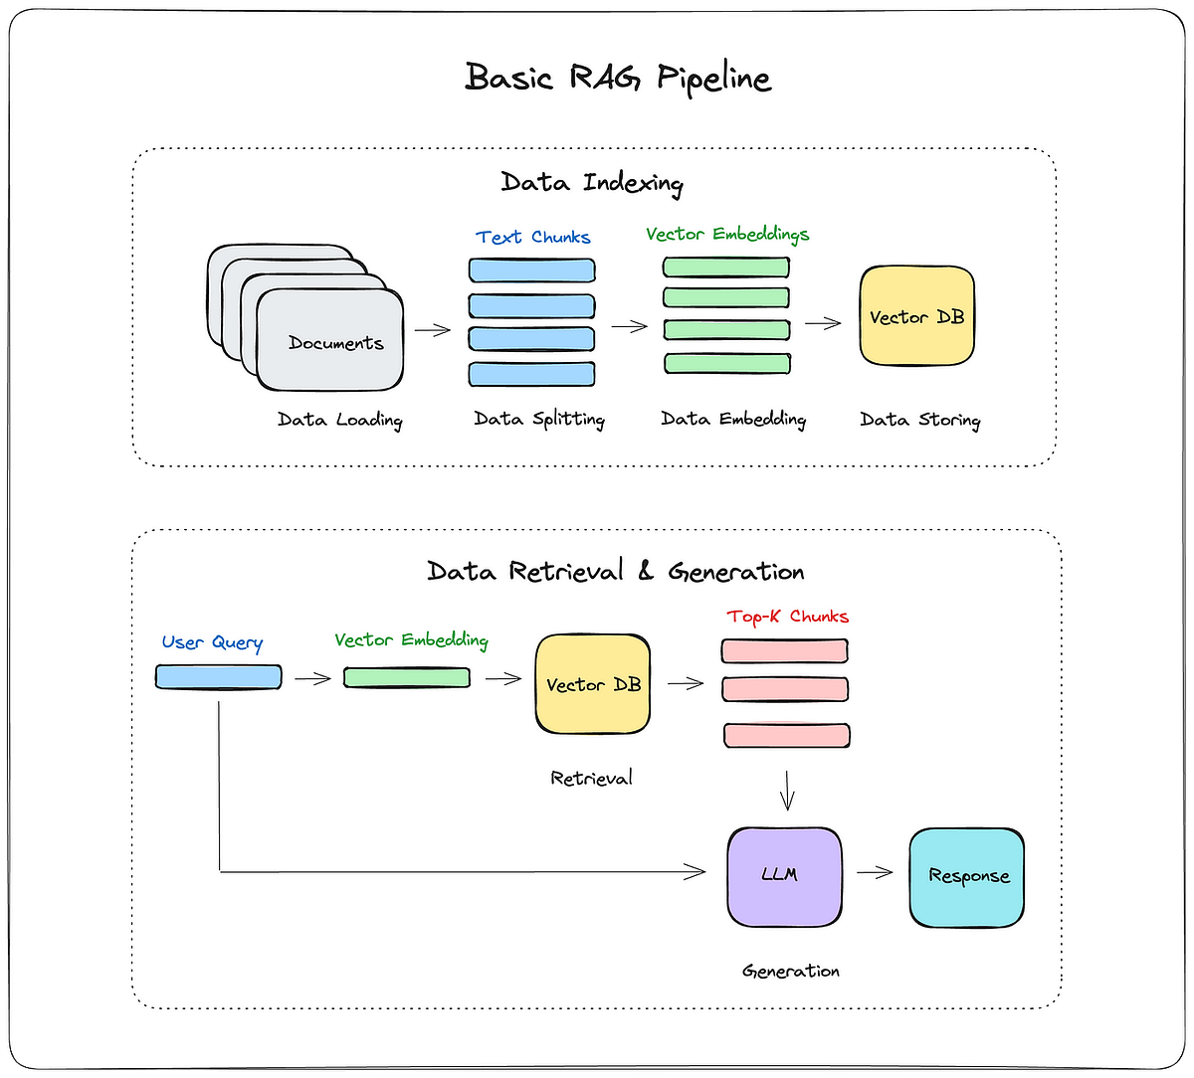
What is Retrieval Augmented Generation (RAG) ?
It is a method that retrieves relevant content from a knowledge base before generating answer.
Reduces hallucination and grounds responses from actual course material
Notes:
RAG is a method that retrieves relevant content from a knowledge base before generating answer This reduces hallucination and grounds responses in actual course material.

Slide 7



Baseline System (1st Generation )
C1
D1
Vector Search
Prompt
S1
RRF
Top V Results
D2
Top N Results
LLM
Response
Video
C2
S2
Text Search
Top K Results
D3
Query
C3
Legend:
S3
Azure video Indexer
Chunks of Documents
(Cleaned)
Dense Vector
and
Sparse Matrix
Dense Vector
Sparse Matrix
Azure Open AI
Azure Cosmos DB
Video Indexing Flow
Query Processing Flow
Notes:
Implementing the same idea
The baseline RAG system also has two flows: On the left, the video indexing flow prepares the video. On the right, the query processing flow answers the user.

Slide 8

Baseline System (1st Generation )
C1
D1
Vector Search
Prompt
S1
RRF
Top V Results
D2
Top N Results
LLM
Response
Video
C2
S2
Text Search
Top K Results
D3
Query
C3
Legend:
S3
Azure video Indexer
Chunks of Documents
(Cleaned)
Dense Vector
and
Sparse Matrix
Dense Vector
Sparse Matrix
Azure Open AI
Azure Cosmos DB
Video Indexing Flow
Notes:
In the video indexing flow, the video is uploaded to video indexer.

Slide 9
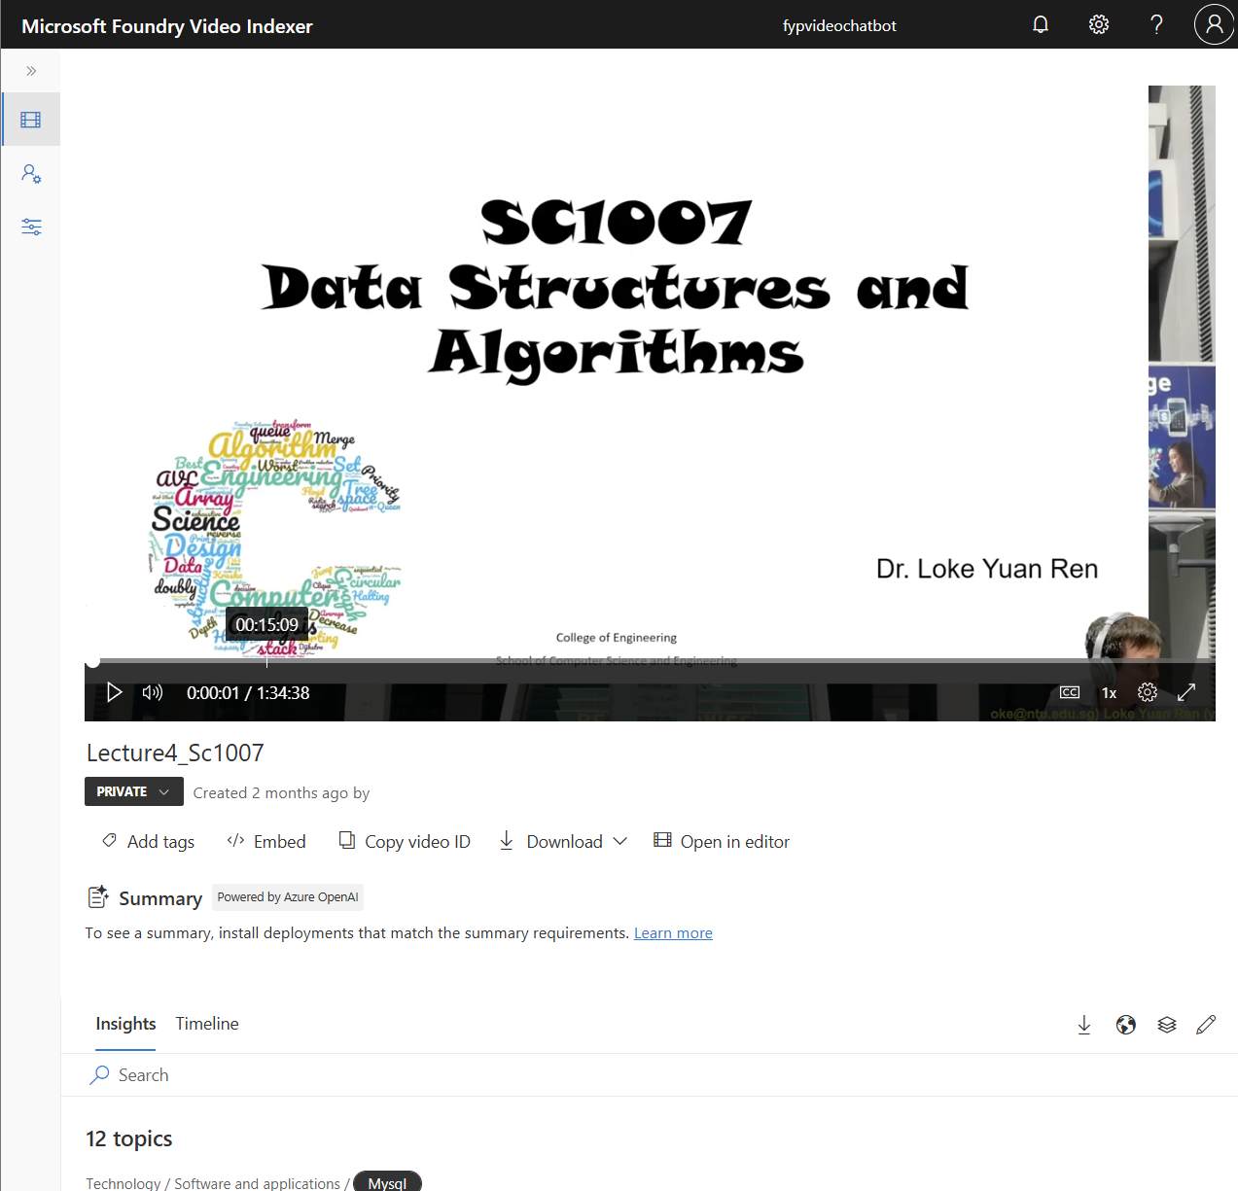


Azure Video Indexer Video to Text
Microsoft’s AI service that automatically analyzes video content
Extracts useful information such as speech-to-text transcripts, speaker detection, and on-screen text through OCR.
Notes:
Azure Video Indexer is an AI service that converts lecture videos into usable text through speech-to-text and Optical Character Recognition (OCR). This text forms the foundation for indexing and later retrieval.

Slide 10
Baseline System (1st Generation )
Transcript Cleaning
C1
D1
Vector Search
Prompt
S1
RRF
Top V Results
D2
Top N Results
LLM
Response
Video
C2
S2
Text Search
Top K Results
D3
Query
C3
Legend:
S3
Azure video Indexer
Chunks of Documents
(Cleaned)
Dense Vector
and
Sparse Matrix
Dense Vector
Sparse Matrix
Azure Open AI
Azure Cosmos DB
Video Indexing Flow
Notes:
After indexing, the transcript retrieved is cleaned used an LLM using Azure OpenAI.

Slide 11
Baseline System (1st Generation )
C1
D1
Vector Search
Prompt
S1
RRF
Top V Results
D2
Top N Results
LLM
Response
Video
C2
S2
Text Search
Top K Results
D3
Query
C3
Legend:
S3
Azure video Indexer
Chunks of Documents
(Cleaned)
Dense Vector
and
Sparse Matrix
Dense Vector
Sparse Matrix
Azure Open AI
Azure Cosmos DB
Video Indexing Flow
Notes:
Next the transcripts are broken up into chunks

Slide 12

Baseline System (1st Generation )
C1
D1
Vector Search
Prompt
S1
RRF
Top V Results
D2
Top N Results
LLM
Response
Video
C2
S2
Text Search
Top K Results
D3
Query
C3
Legend:
S3
Azure video Indexer
Chunks of Documents
(Cleaned)
Dense Vector
and
Sparse Matrix
Dense Vector
Sparse Matrix
Azure Open AI
Azure Cosmos DB
Video Indexing Flow
Notes:
And then converted into embedding. One for dense vector which is used for sematic search and another is sparse matrix which is used for keyword search later on.

Slide 13
Baseline System (1st Generation )
C1
D1
Vector Search
Prompt
S1
RRF
Top V Results
D2
Top N Results
LLM
Response
Video
C2
S2
Text Search
Top K Results
D3
Query
C3
Legend:
S3
Azure video Indexer
Chunks of Documents
(Cleaned)
Dense Vector
and
Sparse Matrix
Dense Vector
Sparse Matrix
Azure Open AI
Azure Cosmos DB
Video Indexing Flow
Notes:
After which, the embeddings are stored In the database which In this case Azure Cosmos DB.

Slide 14

Baseline System (1st Generation )
C1
D1
Vector Search
Prompt
S1
RRF
Top V Results
D2
Top N Results
LLM
Response
Video
C2
S2
Text Search
Top K Results
D3
Query
C3
Legend:
S3
Azure video Indexer
Chunks of Documents
(Cleaned)
Dense Vector
and
Sparse Matrix
Dense Vector
Sparse Matrix
Azure Open AI
Azure Cosmos DB
Query Processing Flow
Notes:
Moving on the query processing flow,
When the query comes in, it is converted into embeddings.

Slide 15
Baseline System (1st Generation )
C1
D1
Vector Search
Prompt
S1
RRF
Top V Results
D2
Top N Results
LLM
Response
Video
C2
S2
Text Search
Top K Results
D3
Query
C3
Legend:
S3
Azure video Indexer
Chunks of Documents
(Cleaned)
Dense Vector
and
Sparse Matrix
Dense Vector
Sparse Matrix
Azure Open AI
Azure Cosmos DB
Query Processing Flow
Notes:
This query embedding is used to retrieved from the database
The TOP V and TOP K results from each of the search are retrieved.

Slide 16
Baseline System (1st Generation )
C1
D1
Vector Search
Prompt
S1
RRF
Top V Results
D2
Top N Results
LLM
Response
Video
C2
S2
Text Search
Top K Results
D3
Query
C3
Legend:
S3
Azure video Indexer
Chunks of Documents
(Cleaned)
Dense Vector
and
Sparse Matrix
Dense Vector
Sparse Matrix
Azure Open AI
Azure Cosmos DB
Query Processing Flow
Notes:
These chunks are ranked again as the top N results using RRF (reciprocal Rank fusion).

Slide 17
Baseline System (1st Generation )
C1
D1
Vector Search
Prompt
S1
RRF
Top V Results
D2
Top N Results
LLM
Response
Video
C2
S2
Text Search
Top K Results
D3
Query
C3
Legend:
S3
Azure video Indexer
Chunks of Documents
(Cleaned)
Dense Vector
and
Sparse Matrix
Dense Vector
Sparse Matrix
Azure Open AI
Azure Cosmos DB
Query Processing Flow
Notes:
The LLM generates a response.

Slide 18

Baseline System (1st Generation )
C1
D1
Vector Search
Prompt
S1
RRF
Top V Results
D2
Top N Results
LLM
Response
Video
C2
S2
Text Search
Top K Results
D3
Query
C3
Legend:
S3
Azure video Indexer
Chunks of Documents
(Cleaned)
Dense Vector
and
Sparse Matrix
Dense Vector
Sparse Matrix
Azure Open AI
Azure Cosmos DB
Query Processing Flow

Slide 19

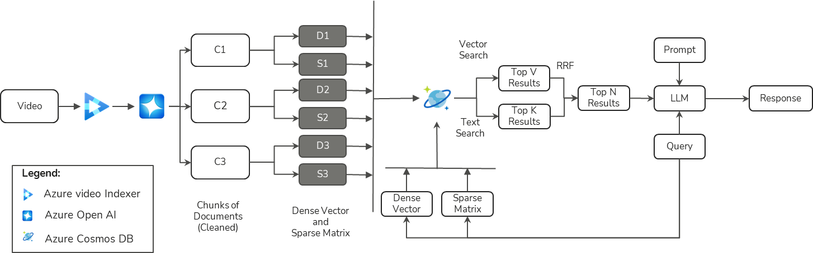
Limitations of Baseline System
Lacked temporal understanding of video content.
Could only retrieve from one video at a time, thus no comparison between videos can be made.
Requires testing on larger, multi-video datasets.
Notes:
However, the baseline system had three major limitations:
It lacked temporal understanding
It could only retrieve from one video at a time, no cross-video comparison can be done.
It wasn’t tested on large multi-video datasets, and the pre-processing pipeline needed refinement.

Slide 20
Project Objectives
Video Indexing Flow Enhancement
Enhance efficiency of uploading long videos to Azure Video Indexer.
Improve context granularity and retrieval accuracy within the knowledge base.
Query Processing Flow Enhancement
Temporal Understanding by strengthening the system’s ability to answer time-sensitive questions.
Retrieval Expansion by enabling flexible retrieval across single or multiple resources efficiently.
Notes:
This project aims to solve those limitations through two major improvements: First, to enhance the video indexing flow by improving upload efficiency and retrieval granularity. Second, to enhance the query flow with better temporal understanding and multi-video retrieval.
This results in a more accurate and context-aware learning companion.

Slide 21
02
Implementation
Temporal Module | Document Scope Module | Evaluation

Slide 22
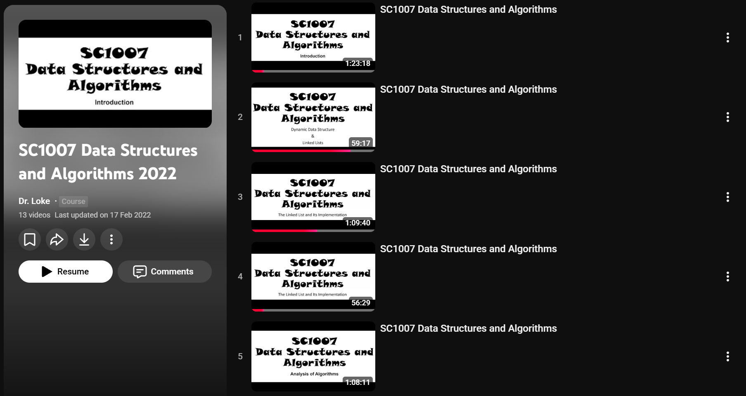
Lecture Sample Videos for Testing
Dataset Used for Testing
SC1007 Data Structure & Algorithm lecture videos by Dr. Loke Yuan
Up to 5 videos selected
Each video: 65–85 minutes long
Used as ground truth for temporal, single-doc, and multi-doc testing
Notes:
The system was tested on five SC1007 Data Structures and Algorithms lectures by Dr. Loke Yuan, each 65–85 minutes long. These serve as the ground truth dataset for temporal, single-document, and multi-document evaluation.

Slide 23

1st Main Enhancement:
Limitation of Baseline
Lacked temporal understanding of video content.
System unable to retrieve chunks based on specific timestamps in queries.
Solution: Temporal Identifier Module
LLM detects temporal intent and extracts timestamp anchors.
Retrieves only chunks within ±2 minutes of the identified time window.
Adds enriched timestamp metadata to chunks.
Improve temporal precision and faithfulness in evaluation
Notes:
For the first enhancement, it targets the limitation of the baseline system could not answer timestamp-based questions.
To address this, I implemented the Temporal Identifier Module.
This module uses an LLM to detect time references, normalizes them, and retrieves chunks within a ±2-minute window.
Each chunk now contains enriched metadata — start and end timestamps — enabling precise temporal retrieval.

Slide 24
Temporal Identifier Module
Timestamp
Search
Relevant Docs
C1 with
Metadata
D1
Vector Search
Prompt
S1
RRF
Top V Results
D2
Top N Results
LLM
Response
Video
C2 with
Metadata
S2
Text Search
Top K Results
D3
Extract Timestamp
C3 with Metadata
S3
Legend:
Chunks of Documents
(Cleaned)
Dense Vector
and
Sparse Matrix
Dense Vector
Sparse Matrix
Metadata
Temporal Qns
Azure video Indexer
Azure Open AI
LLM
Azure Cosmos DB
Non Temporal Qns
Query Analysis
Query
Notes:
Let's dive into the system pipeline enhancement, they are all coloured green.
During indexing, timestamps are added to each chunk.

Slide 25
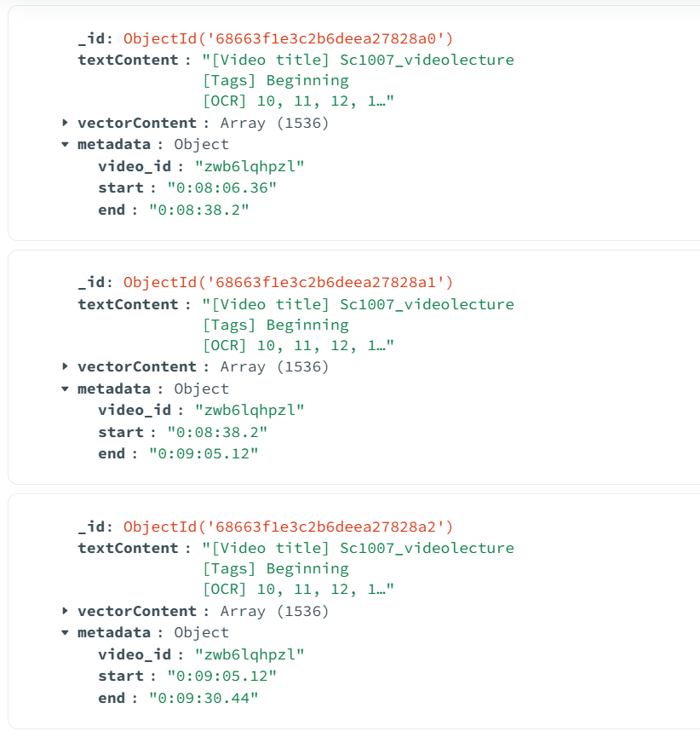
Temporal Identifier Module
Chunks inserted with start and end timestamps as the metadata
Enables timestamp retrieval
Notes:
Here is the example of a 3 chunks inserted with the timestamp as metadata to allow timestamp retrieval.

Slide 26
Temporal Identifier Module
Timestamp
Search
Relevant Docs
C1 with
Metadata
D1
Vector Search
Prompt
S1
RRF
Top V Results
D2
Top N Results
LLM
Response
Video
C2 with
Metadata
S2
Text Search
Top K Results
D3
Extract Timestamp
C3 with Metadata
S3
Legend:
Chunks of Documents
(Cleaned)
Dense Vector
and
Sparse Matrix
Dense Vector
Sparse Matrix
Metadata
Temporal Qns
Azure video Indexer
Azure Open AI
LLM
Azure Cosmos DB
Non Temporal Qns
Query Analysis
Query
Notes:
During query time, the LLM identifies whether the question is temporal.

Slide 27

Temporal Identifier Module
Timestamp
Search
Relevant Docs
C1 with
Metadata
D1
Vector Search
Prompt
S1
RRF
Top V Results
D2
Top N Results
LLM
Response
Video
C2 with
Metadata
S2
Text Search
Top K Results
D3
Extract Timestamp
C3 with Metadata
S3
Legend:
Chunks of Documents
(Cleaned)
Dense Vector
and
Sparse Matrix
Dense Vector
Sparse Matrix
Metadata
Temporal Qns
Azure video Indexer
Azure Open AI
LLM
Azure Cosmos DB
Non Temporal Qns
Query Analysis
Query
Notes:
The system extracts timestamps in JSON format.

Slide 28
Temporal Identifier Module
Timestamp
Search
Relevant Docs
C1 with
Metadata
D1
Vector Search
Prompt
S1
RRF
Top V Results
D2
Top N Results
LLM
Response
Video
C2 with
Metadata
S2
Text Search
Top K Results
D3
Extract Timestamp
C3 with Metadata
S3
Legend:
Chunks of Documents
(Cleaned)
Dense Vector
and
Sparse Matrix
Dense Vector
Sparse Matrix
Metadata
Temporal Qns
Azure video Indexer
Azure Open AI
LLM
Azure Cosmos DB
Non Temporal Qns
Query Analysis
Query
Notes:
Only chunks within the time window are retrieved.

Slide 29
Temporal Identifier Module
Timestamp
Search
Relevant Docs
C1 with
Metadata
D1
Vector Search
Prompt
S1
RRF
Top V Results
D2
Top N Results
LLM
Response
Video
C2 with
Metadata
S2
Text Search
Top K Results
D3
Extract Timestamp
C3 with Metadata
S3
Legend:
Chunks of Documents
(Cleaned)
Dense Vector
and
Sparse Matrix
Dense Vector
Sparse Matrix
Metadata
Temporal Qns
Azure video Indexer
Azure Open AI
LLM
Azure Cosmos DB
Non Temporal Qns
Query Analysis
Query
Notes:
These chunks are then passed to the LLM for answer generation.

Slide 30
Temporal Identifier Module Evaluation
Total of 20 Questions with Ground Truth
No. | Question
1 | What is mentioned at 33 minutes of the lecture?
2 | What was discussed at 27:00 of the lecture?
3 | When was the difference between algorithm and program discussed?
4 | What concept is explained around 45:00 into the lecture?
5 | At what point in the lecture does it start discussing How do we solve the different searching, graph and combinatorial problems?
Notes:
For evaluation, a total of 20 question with ground truth were created. Here are 5 examples.

Slide 31
2nd Main Enhancement:
Limitation of Baseline
Retrieval limited to one video at a time, thus no cross-video comparison.
Not suitable for larger, multi-video datasets.
Solution: Document Scope Module
LLM classifies question types:
Single Docs query (1 video ref) or Multiple Docs query (2 or more video ref)
Single-doc: query rewritten for semantic + keyword retrieval.
Multiple-doc: query decomposed into sub-queries and results fused with RRF.
To improved precision, faithfulness, and relevancy in evaluation metrics.
Notes:
Moving on to the 2nd main enhancement.
It target the baseline system limitations of only being able to retrieve from one video at a time.
Therefore, I implemented the Document Scope Module.
Where a LLM is used to classify single docs and multi docs queries
For single-document queries, the system rewrites the question for improved retrieval. For multi-document queries, it decomposes the question into sub-questions and retrieves across multiple lectures.

Slide 32
Document Scope Module
D1
Timestamp
Search
Relevant Docs
C1 with
Metadata
Vector Search
Prompt
S1
RRF
D2
Top V Results
Video
C2 with
Metadata
Top N Results
LLM
Response
S2
Text Search
Top K Results
C3 with Metadata
D3
Extract Timestamp
S3
Chunks of Documents
(Cleaned)
Dense Vector
and
Sparse Matrix
Dense Vector
Sparse Matrix
Metadata
Temporal Qns
Legend:
Rewritten Question Sparse
Single Doc
Azure video Indexer
Rewritten Question Dense
Azure Open AI
LLM
Query
Non Temporal Qns
SubQuestion 1
Query Analysis
Azure Cosmos DB
Multi-Doc
SubQuestion 2
Notes:
Here are the new enhancement on the pipeline. They are colored in purple for single docs and blue for multiple docs queries.

Slide 33
Single Document Module
D1
Timestamp
Search
Relevant Docs
C1 with
Metadata
Vector Search
Prompt
S1
RRF
D2
Top V Results
Video
C2 with
Metadata
Top N Results
LLM
Response
S2
Text Search
Top K Results
C3 with Metadata
D3
Extract Timestamp
S3
Chunks of Documents
(Cleaned)
Dense Vector
and
Sparse Matrix
Dense Vector
Sparse Matrix
Metadata
Temporal Qns
Legend:
Rewritten Question Sparse
Single Doc
Azure video Indexer
Rewritten Question Dense
Azure Open AI
LLM
Query
Query Analysis
Azure Cosmos DB
Notes:
Let us dive into the data flow.
First the query is classified and let start with single docs query.

Slide 34
Single Document Module
D1
Timestamp
Search
Relevant Docs
C1 with
Metadata
Vector Search
Prompt
S1
RRF
D2
Top V Results
Video
C2 with
Metadata
Top N Results
LLM
Response
S2
Text Search
Top K Results
C3 with Metadata
D3
Extract Timestamp
S3
Chunks of Documents
(Cleaned)
Dense Vector
and
Sparse Matrix
Dense Vector
Sparse Matrix
Metadata
Temporal Qns
Legend:
Rewritten Question Sparse
Single Doc
Azure video Indexer
Rewritten Question Dense
Azure Open AI
LLM
Query
Query Analysis
Azure Cosmos DB
Notes:
The system produces two rewritten variants:
one optimized for semantic search
one optimized for keyword retrieval

Slide 35
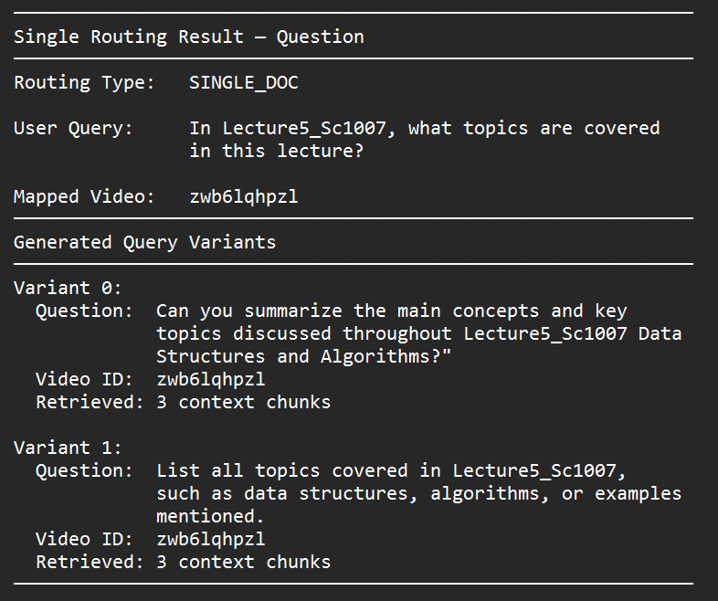
Single Document Query
Skip Slide
If categories as single docs Query, the system rewrites the question into two forms one for semantic search and one for keyword search.
This ensures the answer is accurate and comes from the correct video.
Notes:
An example of a query being rewritten is shown. The main question is rewritten into semantic search, and the other is keyword based questions. This can help to retrieve better in the hybrid search in the pipeline.

Slide 36
Single Document Module
D1
Timestamp
Search
Relevant Docs
C1 with
Metadata
Vector Search
Prompt
S1
RRF
D2
Top V Results
Video
C2 with
Metadata
Top N Results
LLM
Response
S2
Text Search
Top K Results
C3 with Metadata
D3
Extract Timestamp
S3
Chunks of Documents
(Cleaned)
Dense Vector
and
Sparse Matrix
Dense Vector
Sparse Matrix
Metadata
Temporal Qns
Legend:
Rewritten Question Sparse
Single Doc
Azure video Indexer
Rewritten Question Dense
Azure Open AI
LLM
Query
Query Analysis
Azure Cosmos DB
Notes:
Next, Each rewritten query is converted into embeddings.

Slide 37
Single Document Module
D1
Timestamp
Search
Relevant Docs
C1 with
Metadata
Vector Search
Prompt
S1
RRF
D2
Top V Results
Video
C2 with
Metadata
Top N Results
LLM
Response
S2
Text Search
Top K Results
C3 with Metadata
D3
Extract Timestamp
S3
Chunks of Documents
(Cleaned)
Dense Vector
and
Sparse Matrix
Dense Vector
Sparse Matrix
Metadata
Temporal Qns
Legend:
Rewritten Question Sparse
Single Doc
Azure video Indexer
Rewritten Question Dense
Azure Open AI
LLM
Query
Query Analysis
Azure Cosmos DB
Notes:
And the embedded questions are used to do sematic and keyword search.

Slide 38
Single Document Module
D1
Timestamp
Search
Relevant Docs
C1 with
Metadata
Vector Search
Prompt
S1
RRF
D2
Top V Results
Video
C2 with
Metadata
Top N Results
LLM
Response
S2
Text Search
Top K Results
C3 with Metadata
D3
Extract Timestamp
S3
Chunks of Documents
(Cleaned)
Dense Vector
and
Sparse Matrix
Dense Vector
Sparse Matrix
Metadata
Temporal Qns
Legend:
Rewritten Question Sparse
Single Doc
Azure video Indexer
Rewritten Question Dense
Azure Open AI
LLM
Query
Query Analysis
Azure Cosmos DB
Notes:
RRF fuses the results before passing them into the LLM.
This improves retrieval accuracy by restricting search to the correct lecture.

Slide 39
Single Document Module Evaluation
Total of 30 Questions with Ground Truth
No. | Question
1 | According to the lecturer in Sc1007_videolecture, is the lab graded, and how is attendance handled?
2 | In Sc1007_videolecture, what penalty does the lecturer state for plagiarism in assignments?
3 | List the three essential characteristics of an algorithm mentioned by the lecturer in Sc1007_videolecture.
4 | When is the combined lab test and quiz scheduled, and what does the quiz cover mentioned in Sc1007_videolecture.
5 | In the factorial example with a while loop mentioned in Lecture2_Sc1007, how does computational time scale with N?
Notes:
For evaluation, a total of 30 question with ground truth were created. Here are 5 examples.

Slide 40
Multiple Document Module
D1
Timestamp
Search
Relevant Docs
C1 with
Metadata
Vector Search
Prompt
S1
RRF
D2
Top V Results
Video
C2 with
Metadata
Top N Results
LLM
Response
S2
Text Search
Top K Results
C3 with Metadata
D3
Extract Timestamp
S3
Chunks of Documents
(Cleaned)
Dense Vector
and
Sparse Matrix
Dense Vector
Sparse Matrix
Metadata
Temporal Qns
Legend:
Azure video Indexer
Azure Open AI
LLM
Query
SubQuestion 1
Query Analysis
Azure Cosmos DB
Non Temporal Qns
Multi-Doc
SubQuestion 2
Notes:
For multi-document queries, the query is decomposed into two sub-questions.

Slide 41
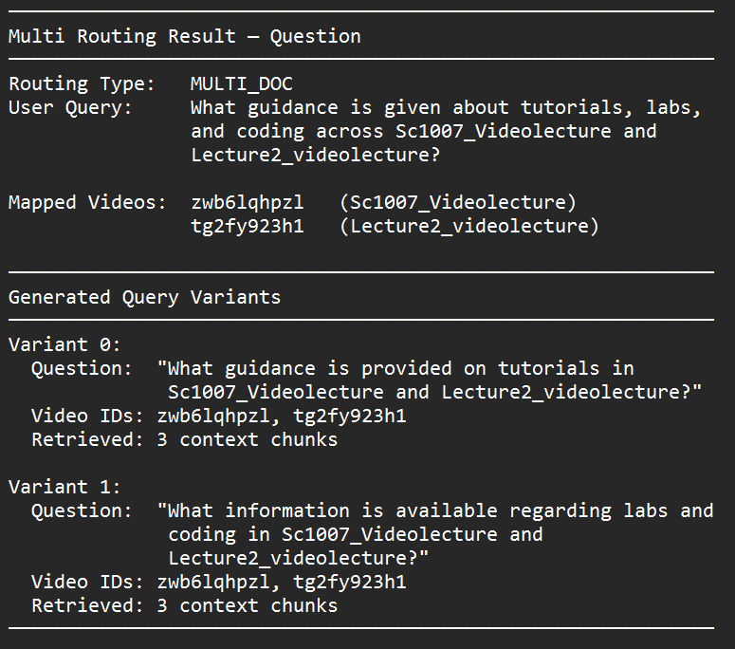
Multiple Document Query
Skip Slide
If categories as Multi docs Query, the system rewrites the question into two smaller sub-questions.
This handle questions that require knowledge from several videos.
Notes:
An example of a query being decomposed is shown. The main question is rewritten into 2 different questions but similar idea. This can help simplify complex and ambiguous questions.

Slide 42
Multiple Document Module
D1
Timestamp
Search
Relevant Docs
C1 with
Metadata
Vector Search
Prompt
S1
RRF
D2
Top V Results
Video
C2 with
Metadata
Top N Results
LLM
Response
S2
Text Search
Top K Results
C3 with Metadata
D3
Extract Timestamp
S3
Chunks of Documents
(Cleaned)
Dense Vector
and
Sparse Matrix
Dense Vector
Sparse Matrix
Metadata
Temporal Qns
Legend:
Azure video Indexer
Azure Open AI
LLM
Query
SubQuestion 1
Query Analysis
Azure Cosmos DB
Non Temporal Qns
Multi-Doc
SubQuestion 2
Notes:
Each sub-question is embedded individually.

Slide 43
Multiple Document Module
D1
Timestamp
Search
Relevant Docs
C1 with
Metadata
Vector Search
Prompt
S1
RRF
D2
Top V Results
Video
C2 with
Metadata
Top N Results
LLM
Response
S2
Text Search
Top K Results
C3 with Metadata
D3
Extract Timestamp
S3
Chunks of Documents
(Cleaned)
Dense Vector
and
Sparse Matrix
Dense Vector
Sparse Matrix
Metadata
Temporal Qns
Legend:
Azure video Indexer
Azure Open AI
LLM
Query
SubQuestion 1
Query Analysis
Azure Cosmos DB
Non Temporal Qns
Multi-Doc
SubQuestion 2
Notes:
Hybrid retrieval is performed.

Slide 44
Multiple Document Module
D1
Timestamp
Search
Relevant Docs
C1 with
Metadata
Vector Search
Prompt
S1
RRF
D2
Top V Results
Video
C2 with
Metadata
Top N Results
LLM
Response
S2
Text Search
Top K Results
C3 with Metadata
D3
Extract Timestamp
S3
Chunks of Documents
(Cleaned)
Dense Vector
and
Sparse Matrix
Dense Vector
Sparse Matrix
Metadata
Temporal Qns
Legend:
Azure video Indexer
Azure Open AI
LLM
Query
SubQuestion 1
Query Analysis
Azure Cosmos DB
Non Temporal Qns
Multi-Doc
SubQuestion 2
Notes:
RRF merges results from different lectures.

Slide 45
Multiple Document Module
D1
Timestamp
Search
Relevant Docs
C1 with
Metadata
Vector Search
Prompt
S1
RRF
D2
Top V Results
Video
C2 with
Metadata
Top N Results
LLM
Response
S2
Text Search
Top K Results
C3 with Metadata
D3
Extract Timestamp
S3
Chunks of Documents
(Cleaned)
Dense Vector
and
Sparse Matrix
Dense Vector
Sparse Matrix
Metadata
Temporal Qns
Legend:
Azure video Indexer
Azure Open AI
LLM
Query
SubQuestion 1
Query Analysis
Azure Cosmos DB
Non Temporal Qns
Multi-Doc
SubQuestion 2
Notes:
The LLM then generates the final answer.
This enables cross-lecture reasoning, something the baseline system could not do.

Slide 46
Multiple Document Module Evaluation
Total of 30 Questions with Ground Truth
No. | Question
1 | Across the two lectures Sc1007_Videolecture and Lecture2_videolecture, which topics are planned after the analysis of algorithms and when might hash tables be covered?
2 | "Which lecture between Sc1007_Videolecture and Lecture2_videolecture, previews asymptotic notation and which one defines Big O, Big Omega, and Big Theta in detail?"
3 | Summarize how recursion impacts time and space across the Sc1007_Videolecture and Lecture2_videolecture lectures using examples given.
4 | From both lectures Sc1007_Videolecture and Lecture2_videolecture, what is the difference between an algorithm and a program, and how is efficiency evaluated?
5 | Combine the examples: which method is most efficient for summing 1.N, and how is this justified by the complexity principles in both Sc1007_Videolecture and Lecture2_videolecture lectures.
Notes:
Similarly to single docs, for evaluation, a total of 30 question with ground truth were created. Here are 5 examples.

Slide 47
03
Evaluation
RAGAS Framework | User Testing

Slide 48
1st Evaluation –
Retrieval Augmented Generation Assessment (RAGAS) Metrics
Metric | Definition
Content Precision | The fraction of retrieved context chunks that are relevant to the query.
Context Recall | The fraction of all relevant chunks that were successfully retrieved from the knowledgebase.
Faithfulness | This checks whether the generated answer is factually consistent with the retrieved context with no hallucinations.
Answer Relevancy | This measures how well the generated answer addresses the user's query
Notes:
I evaluated the system using RAGAS, which measures:
Content Precision
Context Recall
Faithfulness
Answer Relevancy
Across all metrics, the enhanced pipeline significantly outperformed the baseline system

Slide 49
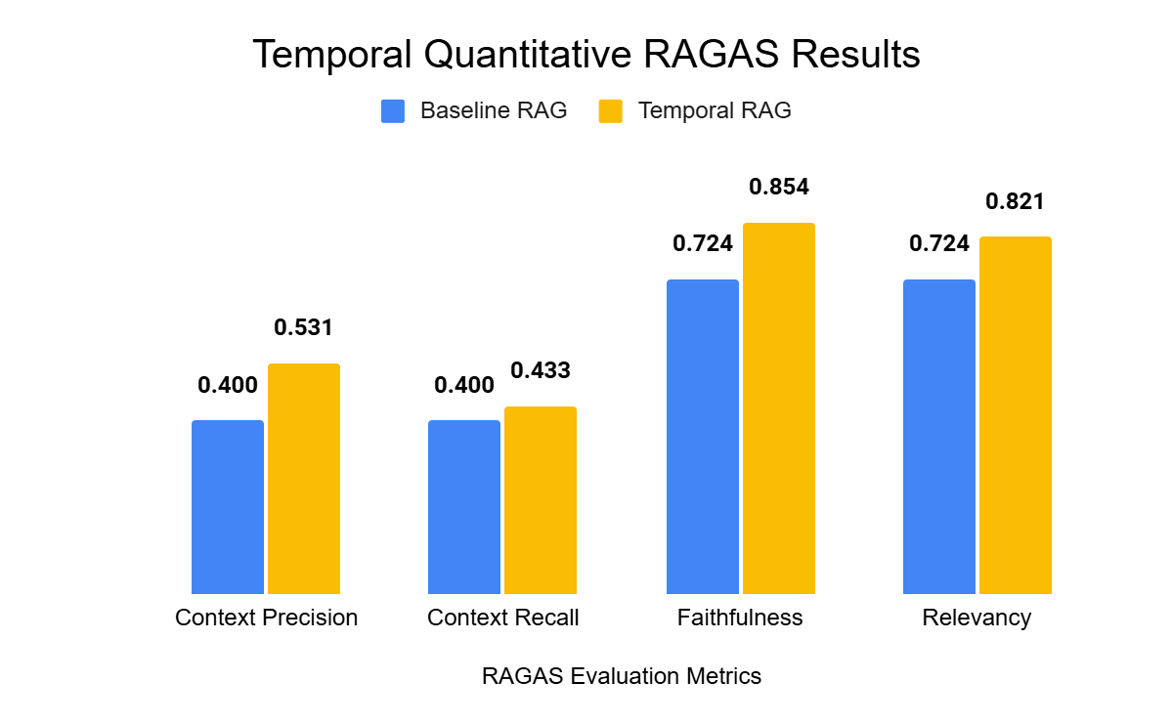
Temporal Identifier Quantitative Results
Pipeline | Time Taken (Seconds)
Baseline RAG | 3.68
Temporal RAG | 4.93
Notes:
For temporal enhanced pipeline, outperformed the baseline in all metrics. Although processing time increased by about 1.25 seconds, the accuracy improvements justify the trade-off.

Slide 50
Temporal Identifier Qualitative Results
Question:
What is mentioned at 33 minutes of the lecture?
Ground Truth:
At the 33-minute mark, the lecturer mentioned that the module will mainly cover problem types such as searching, graph problems, and combinatorial problems involving permutations.
Baseline System
Temporal System
I am unable to find an answer for the specific content mentioned at 33 minutes of the lecture. The provided transcript does not include any information from that timestamp. If you have any other questions or need information from a different part of the lecture, feel free to ask!
At 33 minutes of the lecture, the speaker discusses the various types of problems covered in the module, including searching, graph problems, and combinatorial problems, which involve permutations and combinations. They also mention that in the next level, topics such as sorting strings, processing, and geometric and numerical problems will be introduced. This section emphasizes the breadth of topics that will be explored in the course. This information is "Covered at 33:19."
Skip Slide
Notes:
A qualitative example shows that the baseline failed to retrieve the segment at the 33-minute mark, while the enhanced system retrieved the exact explanation with near-perfect RAGAS scores.

Slide 51
Temporal Identifier Qualitative Results
Baseline System
Temporal System
I am unable to find an answer for the specific content mentioned at 33 minutes of the lecture. The provided transcript does not include any information from that timestamp. If you have any other questions or need information from a different part of the lecture, feel free to ask!
At 33 minutes of the lecture, the speaker discusses the various types of problems covered in the module, including searching, graph problems, and combinatorial problems, which involve permutations and combinations. They also mention that in the next level, topics such as sorting strings, processing, and geometric and numerical problems will be introduced. This section emphasizes the breadth of topics that will be explored in the course. This information is "Covered at 33:19."
Context Precision | Context Recall | Faithfulness | Relevancy
0 | 0 | 0.667 | 0
Context Precision | Context Recall | Faithfulness | Relevancy
0.5 | 1.0 | 1.0 | 0.959
Skip Slide

Slide 52
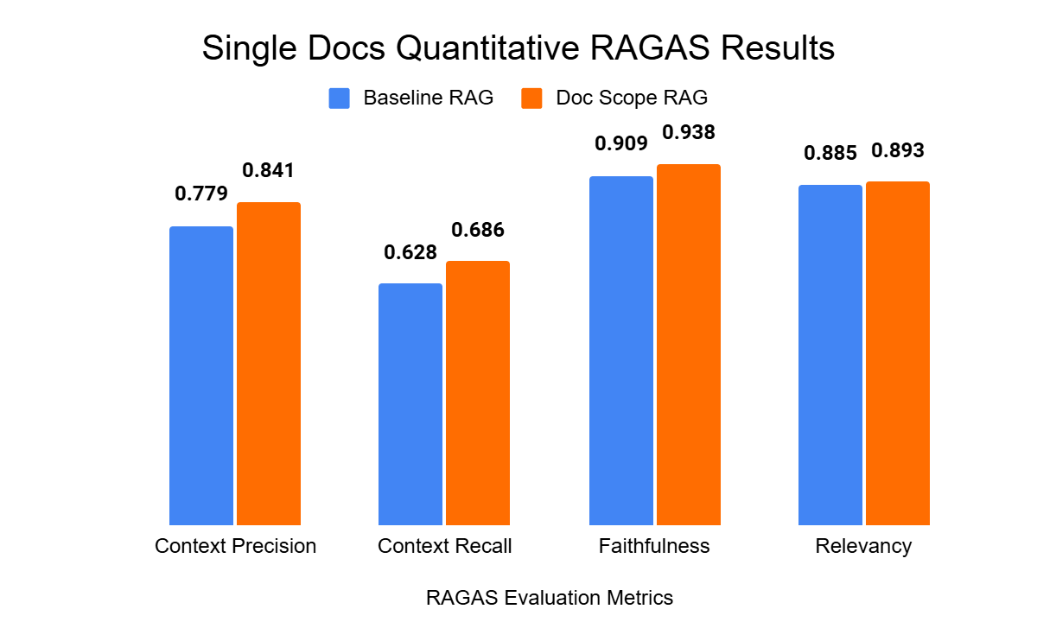
Single Document Quantitative Results
Pipeline | Time Taken (Seconds)
Baseline RAG | 4.80
Docs Scope RAG | 7.35
Notes:
For single-document pipeline, it improved across all metrics.
Latency increased slightly, from 4.8 to 7.35 seconds, but accuracy improved significantly.
This improved precision, faithfulness, and relevancy, despite slightly higher latency.

Slide 53
Single Document Qualitative Results
Question:
In Lecture5_Sc1007, what topics are covered in this lecture?
Ground Truth:
Graph Representation, specifically Adjacency Matrix and Adjacency List (mentioned in 0:09:48).
Baseline System
Temporal System
In Lecture5_Sc1007, the topics covered include the traversal of graphs, specifically focusing on two methods: breadth-first search and depth-first search. The lecturer mentions that while there are many ways to traverse graphs, only these two methods will be introduced in the lecture. This is highlighted when the lecturer states, "we only introduce the breadth-first search and depth-first search in the next lecture" and elaborates on the nature of these traversals at timestamps (57:07.48) and (57:29.48).
In Lecture5_Sc1007, the topics covered include an introduction to graphs, how to represent them, and specifically two representations: the adjacency matrix and the adjacency list. Additionally, there is mention of traversing graphs, with a focus on breadth-first search and depth-first search, which may be covered in the next lecture if time allows. This is outlined at various points in the lecture, particularly at "Covered at 09:04" for the introduction to graphs and "Covered at 09:35" for the representations. The traversal methods are mentioned towards the end, with a specific note on their introduction in the next lecture at "Covered at 57:07"
Skip Slide

Slide 54
Single Document Qualitative Results
Baseline System
Temporal System
In Lecture5_Sc1007, the topics covered include the traversal of graphs, specifically focusing on two methods: breadth-first search and depth-first search. The lecturer mentions that while there are many ways to traverse graphs, only these two methods will be introduced in the lecture. This is highlighted when the lecturer states, "we only introduce the breadth-first search and depth-first search in the next lecture" and elaborates on the nature of these traversals at timestamps (57:07.48) and (57:29.48).
In Lecture5_Sc1007, the topics covered include an introduction to graphs, how to represent them, and specifically two representations: the adjacency matrix and the adjacency list. Additionally, there is mention of traversing graphs, with a focus on breadth-first search and depth-first search, which may be covered in the next lecture if time allows. This is outlined at various points in the lecture, particularly at "Covered at 09:04" for the introduction to graphs and "Covered at 09:35" for the representations. The traversal methods are mentioned towards the end, with a specific note on their introduction in the next lecture at "Covered at 57:07"
Context Precision | Context Recall | Faithfulness | Relevancy
0 | 0 | 1 | 0.903
Context Precision | Context Recall | Faithfulness | Relevancy
0.917 | 0.5 | 1 | 0.981
Skip Slide

Slide 55
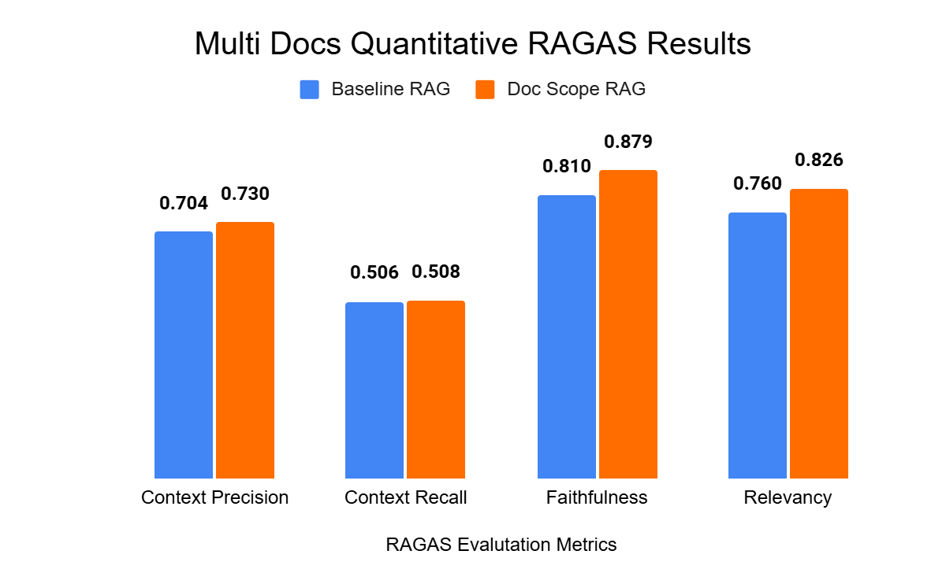
Multi Document Quantitative Results
Pipeline | Time Taken (Seconds)
Baseline RAG | 4.88
Doc Specific RAG | 7.48
Notes:
For multi-document queries, the Multi-Scope Module demonstrated strong improvements.
Although response time increases from 4.88 to 7.48 seconds, the accuracy gain across documents makes it valuable for cross-lecture queries

Slide 56
Multiple Document Qualitative Results
Question: What guidance is given about tutorials, labs, and coding across Sc1007_videolecture and Lecture2_videolecture ?
Ground Truth: In Sc1007_videolecture, the lecturer explained that tutorials focus on concepts while labs focus on practice, and in Lecture2_videolecture the lecturer explained that complexity analysis is taught in lecture, but coding is applied in labs.
Baseline System
Temporal System
In the SC1007 video lecture, guidance regarding tutorials, labs, and coding is provided as follows: 1. **Tutorials**: The tutorials are designed to clarify doubts that students may encounter during lab sessions…This is covered at "Covered at (13:58.60)". 2. **Labs**: The lab sessions focus on practical application and implementation of the concepts learned in lectures. Students are expected to practice coding and apply their knowledge of data structures and algorithms…This is highlighted at "Covered at (01:00:53.12)". 3. **Coding**: The course emphasizes the importance of coding proficiency. Students are expected to implement algorithms and data structures themselves, rather than relying solely on provided solutions… This is discussed at "Covered at (12:38.92)".
In the Sc1007_videolecture, several key points are made regarding tutorials, labs, and coding:
1.**Tutorials**: The tutorials are designed to help students clarify doubts they may have encountered during lab sessions…..This is emphasized at the timestamp ""Covered at 13:58"".
2. **Labs**: Attendance in labs is important, although the lab itself is not graded….This is highlighted at ""Covered at 08:17"“….
3. **Coding**: The emphasis is placed on learning how to code rather than just reading solutions. Students are encouraged to implement solutions themselves to truly understand the material. This guidance is provided at ""Covered at 01:00:53"".
The importance of understanding time complexity and space complexity in coding is also mentioned, particularly in relation to algorithm analysis (""Covered at 57:39"")
Skip Slide

Slide 57
Multiple Document Qualitative Results
Baseline System
Temporal System
In the SC1007 video lecture, guidance regarding tutorials, labs, and coding is provided as follows: 1. **Tutorials**: The tutorials are designed to clarify doubts that students may encounter during lab sessions…This is covered at "Covered at (13:58.60)". 2. **Labs**: The lab sessions focus on practical application and implementation of the concepts learned in lectures. Students are expected to practice coding and apply their knowledge of data structures and algorithms…This is highlighted at "Covered at (01:00:53.12)". 3. **Coding**: The course emphasizes the importance of coding proficiency. Students are expected to implement algorithms and data structures themselves, rather than relying solely on provided solutions… This is discussed at "Covered at (12:38.92)".
In the Sc1007_videolecture, several key points are made regarding tutorials, labs, and coding:
1.**Tutorials**: The tutorials are designed to help students clarify doubts they may have encountered during lab sessions…..This is emphasized at the timestamp ""Covered at 13:58"".
2. **Labs**: Attendance in labs is important, although the lab itself is not graded….This is highlighted at ""Covered at 08:17"“….
3. **Coding**: The emphasis is placed on learning how to code rather than just reading solutions. Students are encouraged to implement solutions themselves to truly understand the material. This guidance is provided at ""Covered at 01:00:53"".
The importance of understanding time complexity and space complexity in coding is also mentioned, particularly in relation to algorithm analysis (""Covered at 57:39"")
Context Precision | Context Recall | Faithfulness | Relevancy
0.589 | 0.5 | 1 | 0.970
Context Precision | Context Recall | Faithfulness | Relevancy
1 | 1 | 1 | 0.935
Skip Slide

Slide 58
2nd Evaluation - User Evaluation
Participants: 13 NTU CCDS students.
Reason for selection: Most had taken SC1007, matching the lecture videos used in the system.
Purpose: Assess students' satisfactions on the chatbot’s temporal reasoning, and multi-video performance.
Survey method: Google Forms.
Survey structure:
Temporal queries
Single-document queries
Multi-document queries
Overall satisfaction
Rating scale: 1 = least satisfied, 5 = most satisfied.
Notes:
For the user evaluations,
I gathered feedback from 13 CCDS students, most of whom had taken SC1007, which aligns with the lecture dataset used in the system. The survey evaluated the chatbot’s accuracy across temporal queries, single-document queries, and multi-document queries, followed by an overall satisfaction section. Responses were collected through Google Forms using a 5-point scale.

Slide 59
Survey Procedure
Skip Slide
Temporal - Procedure (What users did)
Users watched the video Sc1007_Videolecture.
They asked time-based questions, e.g., “What was discussed at 27:00?”
They checked if the chatbot’s answer:
matched the correct timestamp, and
helped them understand that segment.
Document Scope – Procedure (What users did)
Users watched the videos Sc1007_Videolecture and Lecture2_Videolecture
Students asked a single-document question, where the answer should come from one specific lecture.
Example: “When is the combined lab test and quiz scheduled, and what does the quiz cover in Sc1007?”
They checked whether the chatbot retrieved context only from the intended lecture.
Students asked a multi-document question, needing information from both lectures
Example: “What guidance is given about labs, tutorials, and coding across both videos?
They checked whether the chatbot combined the information accurately and coherently.

Slide 60
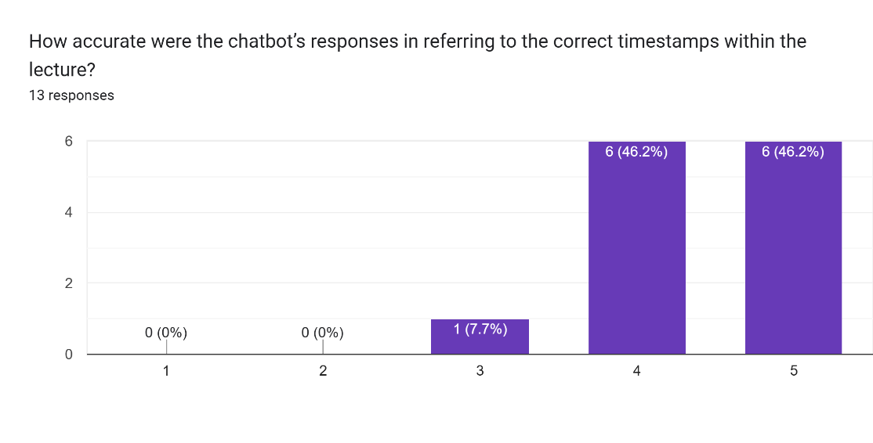
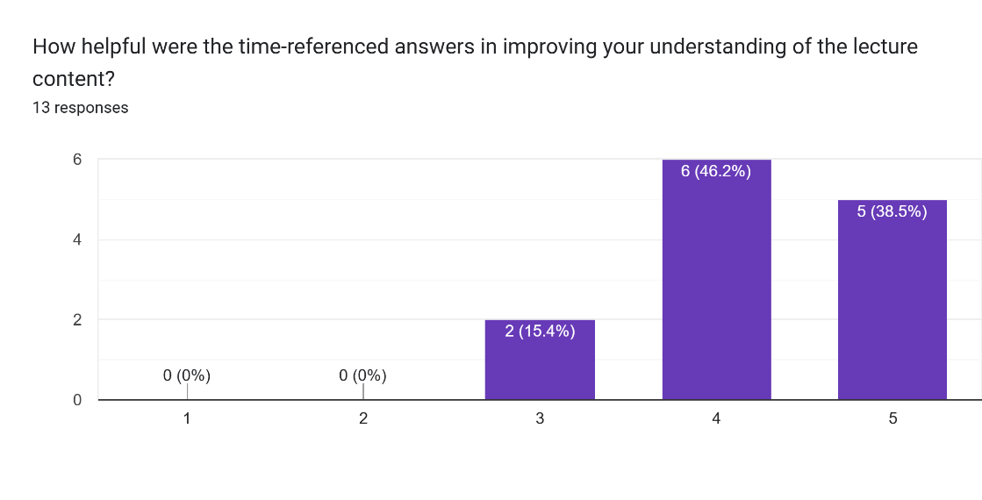
User Evaluation – Temporal
Approx 85% rated the system a 4 or 5 for helping them understand content more efficiently through time-referenced answers.
This shows temporal identifier module improve timestamp retrieval
Notes:
Temporal accuracy: ~85% rated 4 or 5.
This shows that the Temporal Identifier significantly improves timestamp-specific retrieval and the user is satisfied with the answer.

Slide 61
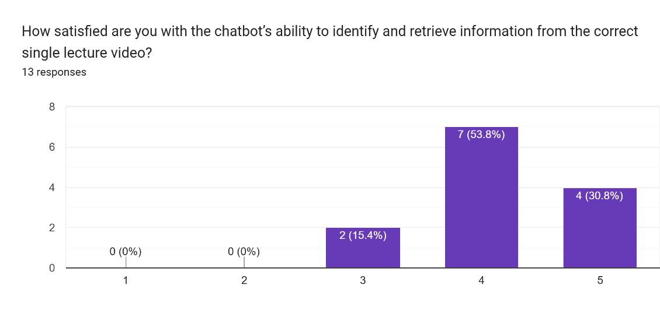
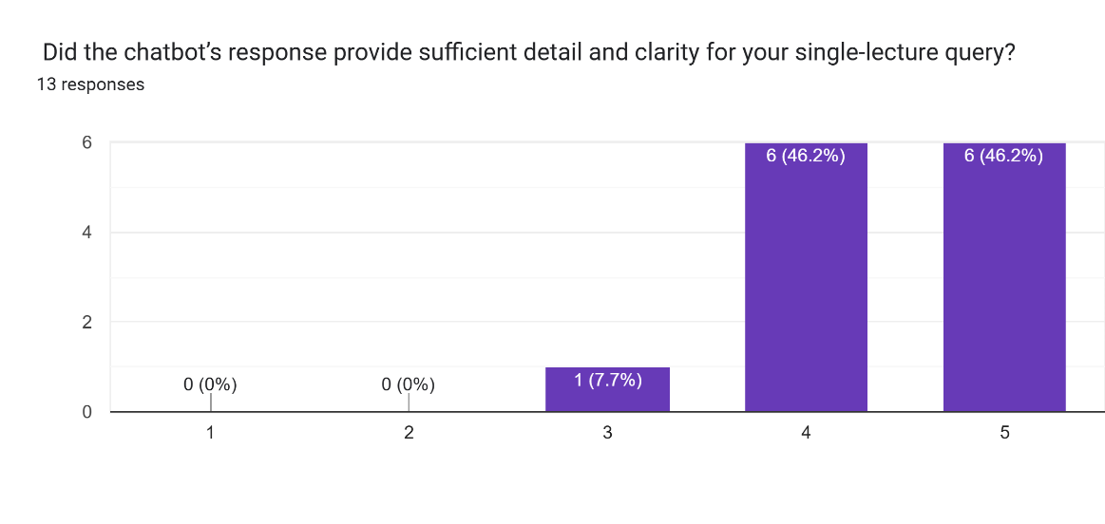
User Evaluation – Single Docs
Over 80% gave a rating of 4 or 5 for both identifying the correct lecture and providing clear, detailed explanations
Supports effectiveness of Single-Scope pipeline in narrowing retrieval to the correct video
Notes:
Single-doc retrieval: Over 80% rated 4 or 5 satisfactory.
This reflects the effectiveness of the Single-Scope Identifier in narrowing retrieval to the correct video.

Slide 62
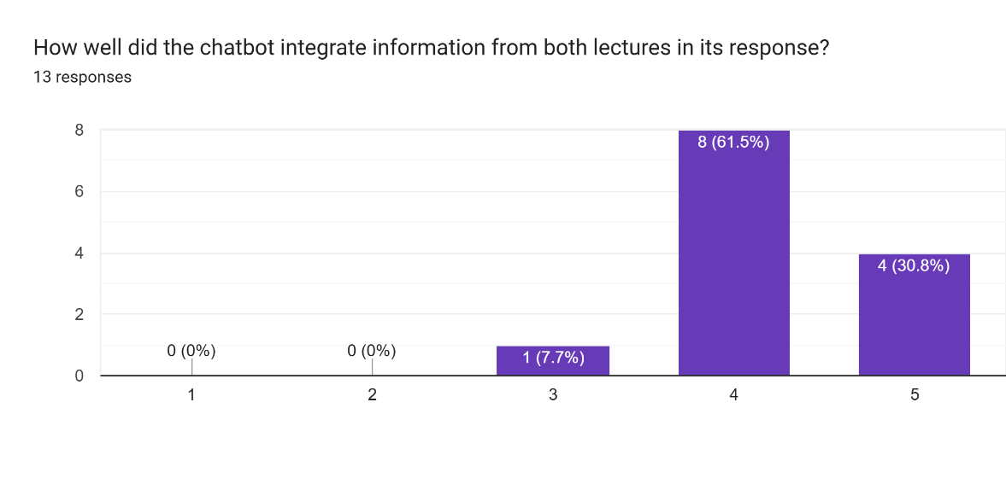
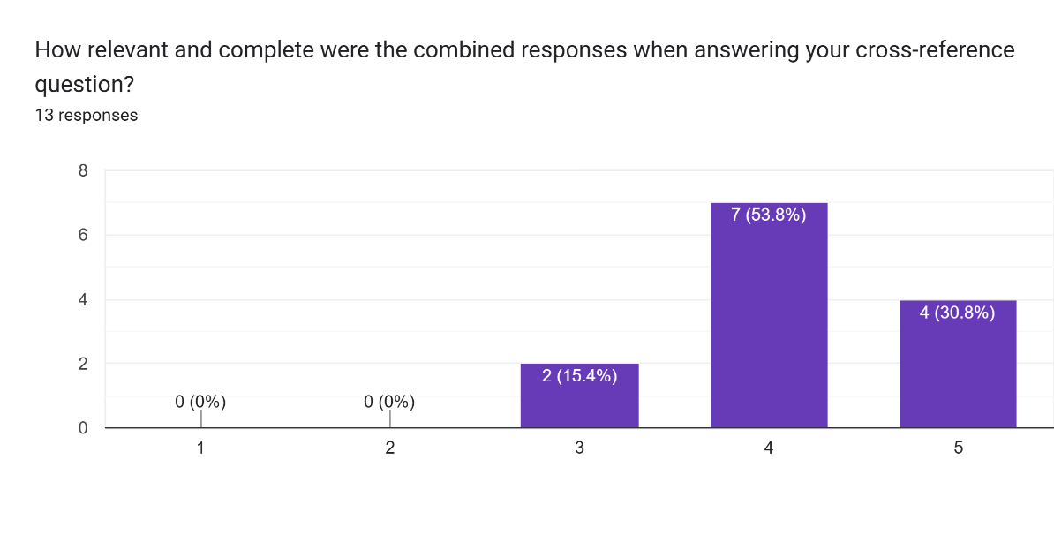
User Evaluation – Multi Docs
More than 80% giving a score of 4 or 5, the system integrated information well across multiple videos,
Supports the benefit of the Multi-Scope pipeline when students need combined explanations.
Notes:
Similarly, Multi-doc reasoning: Over 80% rated 4 or 5 satisfactory.
This supports the benefit of the Multi-Scope Identifier when students need combined explanations.

Slide 63
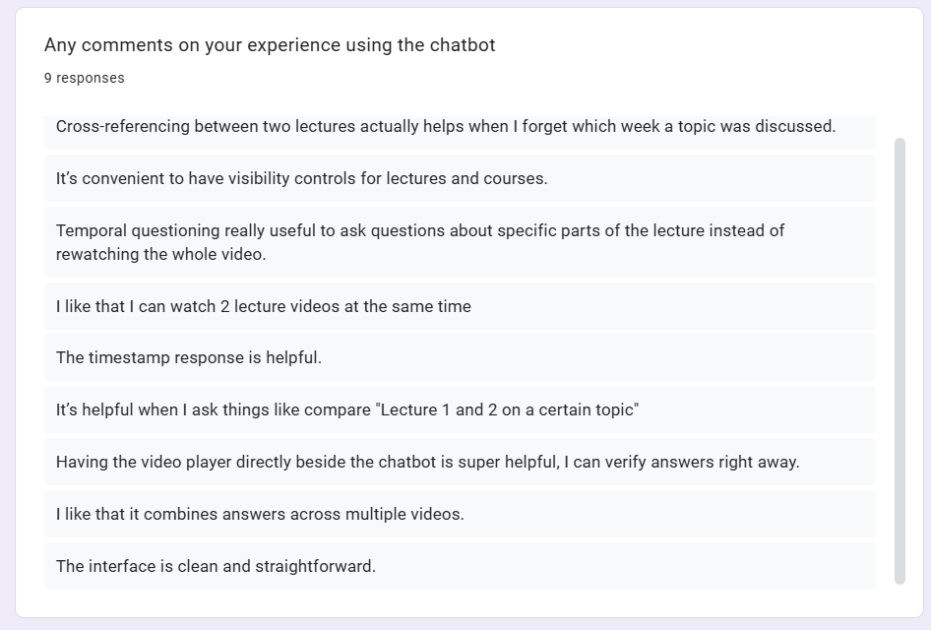
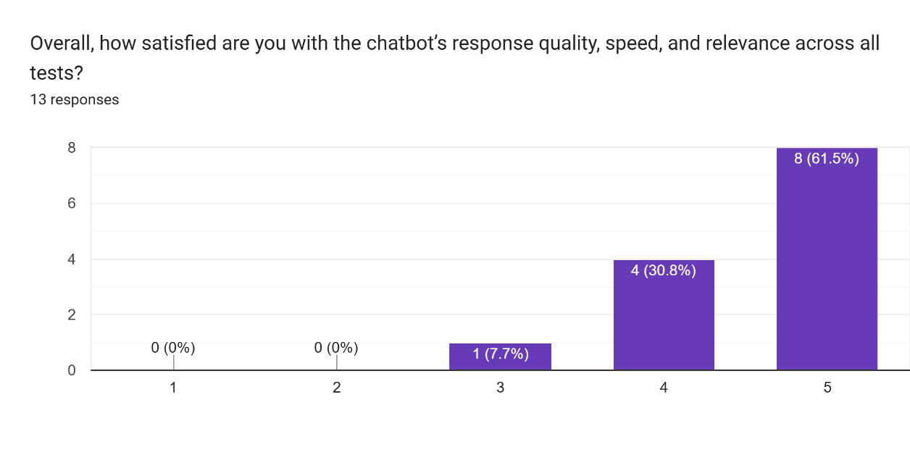
User Evaluation – Overall
Most students rated the system a 4 or 5 in terms of relevance, speed, and response quality.
Open-ended comments highlighted cross-reference lectures, usefulness of timestamp answers.
Overall, improves learning experience.
Notes:
Overall satisfaction: majority rated responses as relevant and useful.
As shown on the open-ended comments, Students especially liked timestamp-aligned answers and the ability to cross-reference lectures.

Slide 64
04
Demonstration
System Architecture | Application Demo

Slide 65
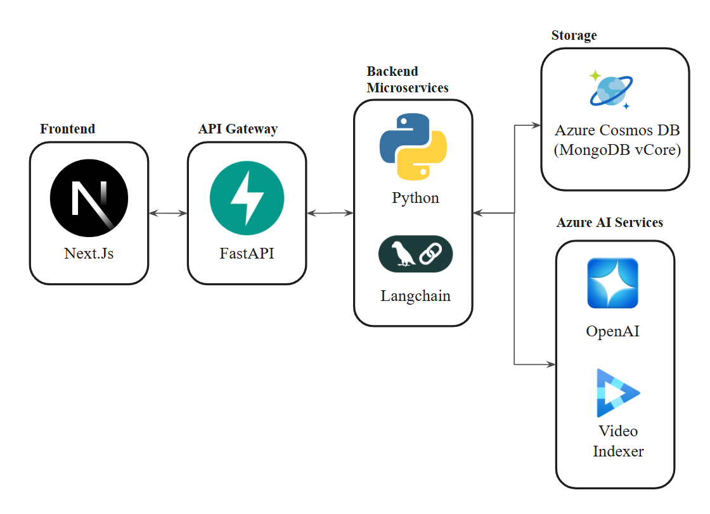
System Architecture
Notes:
Here is the The system architecture.
It includes a Next.js frontend, a FastAPI gateway, and Python-based microservices built with LangChain.
These interact with Azure Cosmos DB, Azure OpenAI, and Azure Video Indexer.
This setup enables the full end-to-end pipeline.

Slide 66


Slide 67
05
Conclusion
Future Development | Other Applications | Overall contribution

Slide 68


Future Development
Integration of Tutorial and Assignment Contexts
Improve holistic reasoning by linking lectures to tutorial exercises
Lecture Slide and PDF Upload Functionality
Using OCR and semantic embeddings to extract text from slides or reference notes (searchable content)
Multi-modal retrieval engine, beyond just videos
Improves Scalability, new learning materials without heavy processing
Notes:
Two major directions for future development:
Integration of tutorial sheets, lab assignments, and lecture slides — enabling the system to connect theory with hands-on practice.
Full PDF and slide upload functionality — allowing multimodal retrieval beyond video transcripts using OCR and embeddings.
These features expand the system into a fully multi-modal learning tool.

Slide 69



To Conclude the Main Contributions
Temporal
Identifier Module
Document
Scope Module
Timestamp accurate retrieval
Single/Multi doc Reasoning
Improve
Retrieval Accuracy
Complete end-to-end system
Enhanced chunking and query rewriting
Usable interface
Notes:
To conclude, this project delivers several contributions:
The Temporal Identifier Module, enabling timestamp-accurate retrieval.
The Document Scope Module, enabling both single-video and multi-video reasoning.
Improved retrieval accuracy through enhanced chunking and query rewriting.
A complete end-to-end system with a usable interface, ready for real students.
Overall, this system provides a more accurate and reliable learning companion, addressing key limitations of the first generation.

Slide 70




Other Applications for this project
Corporate L&D (Learning & Development) / HR Compliance Platforms
Healthcare Training & Clinical Procedure Libraries
Index surgical and training videos
Employees search long compliance or onboarding recordings
Legal & Litigation Support (Deposition or Court Video Analysis)
Customer Support & Technical Documentation for Engineering Firms
Analyze deposition videos with timestamp-based retrieval
Help technicians troubleshooting and repair videos fully searchable
Notes:
This system can be applied across multiple industries:
Healthcare — indexing surgical or training videos.
Corporate training — navigating compliance or onboarding recordings.
Law — analyzing deposition videos.
Engineering — searching troubleshooting videos.

Slide 71
Thank you!
Name: Nicole Kaira Almonte Imatong
Project ID: CCDS24-1273
Supervisor: Mr. Ong Chin Ann

Slide 72
Questions
How were the surveyees chosen? Randomly? Or what year, or from a certain course?
A user testing survey was conducted with 13 NTU students from the College of Computing and Data Science (CCDS) to evaluate the application and gather feedback through Google Forms. The majority had previously taken the SC1007: Data Structures and Algorithms module, which served as the primary video dataset for the system. Their familiarity with the course content allowed for more relevant and contextual feedback on the chatbot’s retrieval and reasoning capabilities.
How should I interpret the satisfaction scores? They are numbers 1 to 5, I assume 5 means the best?
Responses were rated on a five-point Likert scale, where 1 indicated “least satisfied” and 5 indicated “most satisfied”.
Did you consider A/B testing and seeing whether the system indeed improved the satisfaction scores compared to the baseline?
I did a user feedback, but not strictly A/B testing. I did RAGAS to compare the baseline and the enhanced pipeline. It showed it performed significantly well. Therefore, user feedback I focused on evaluating the usefulness of the new features.

